Slide 1
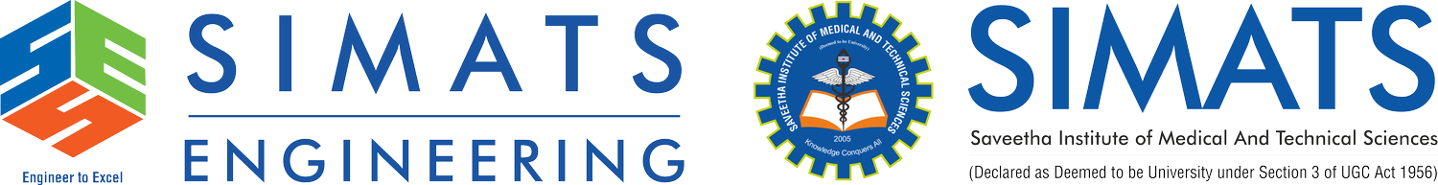
Security Attacks, Threats, Risks and Their Impact on Security Goals
CSA5101 - Cryptography and Network Security
Guided by:
Dr. ANBALAGAN E
Presented by:
Lakshmi Devi J (192524300)
B.Tech AIDS

Slide 2


Introduction
Network systems face different types of security challenges.
Threats are potential causes of security problems.
Attacks are actual attempts to exploit vulnerabilities.
Risks represent the possibility and impact of security incidents.
These can affect the major security goals of information systems.

Slide 3
Security Goals: CIA Triad
The three fundamental security goals are:
Confidentiality – Prevent unauthorized access to information.
Integrity – Ensure information is not improperly modified.
Availability – Ensure systems and information are accessible when needed.
Also:
Authentication – Verify the identity of users.
Non-repudiation – Prevent denial of performed actions.

Slide 4
Security Threats
A security threat is a potential danger to a system or network.
Common threats include:
  Malware
  Phishing
  Insider threats
  Eavesdropping
  Social engineering
  Data theft
Threats may be intentional or accidental.

Slide 5
Security Attacks
A security attack is an attempt to damage, disrupt, access, or manipulate a system.
Passive attacks: Eavesdropping, traffic analysis.
Active attacks: Modification, masquerading, replay attacks, denial-of-service.
Attacks exploit vulnerabilities in systems, networks, or users.

Slide 6
Security Risks
Security risk is the possibility of loss or damage resulting from a threat exploiting a vulnerability.
Risk depends mainly on:
  Threat
  Vulnerability
  Likelihood
  Impact
Example: Weak password → Account compromise → Data theft.

Slide 7
Impact on Security Goals
Attack/Threat | Confidentiality | Integrity | Availability
Eavesdropping | ✓ | – | –
Malware | ✓ | ✓ | ✓
Data modification | – | ✓ | –
DDoS | – | – | ✓
Phishing | ✓ | ✓ | –
Ransomware | ✓ | ✓ | ✓

Slide 8
Real-Time Example: Ransomware Attack
Ransomware is malware that prevents users from accessing their data.
Attackers demand payment to restore access.
It can affect businesses, hospitals, universities, and government systems.
Confidentiality: Sensitive data may be stolen.
Integrity: Files may be modified or encrypted.
Availability: Users cannot access important systems and files.

Slide 9
Security Measures
Use strong passwords and multi-factor authentication.
Apply encryption to sensitive information.
Install security updates and patches.
Use firewalls and intrusion detection systems.
Perform regular backups.
Train users to identify phishing and social-engineering attacks.
Monitor networks for suspicious activity.

Slide 10
Conclusion
Threats create potential security dangers.
Attacks exploit vulnerabilities to cause actual damage.
Risks help organizations understand possible losses.
Attacks can affect confidentiality, integrity, availability, authentication, and non-repudiation.
Effective security requires prevention, detection, response, and recovery.

